Slide 1
SQL-Project Presentation S10011

Slide 2
About Data:
This dataset contains sales transactions from three different branches of Amazon, respectively located in Mandalay, Yangon and Naypyitaw. The data contains 17 columns and 1000 rows:
The major aim of this project is to gain insight into the sales data of Amazon to understand the different factors that affect sales of the different branches.

Slide 3

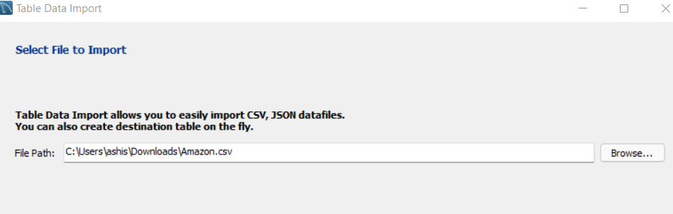
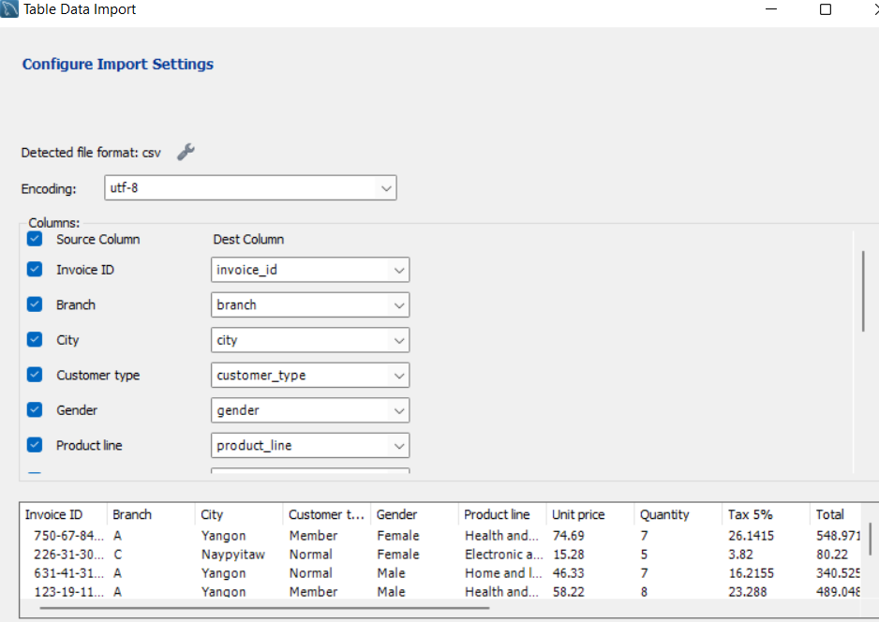
Data Wrangling---- step.] creating database and importing data using table data import wizard --create database amazon; use amazon; SELECT * FROM amazon.amazon_salestb limit 10;

Slide 4
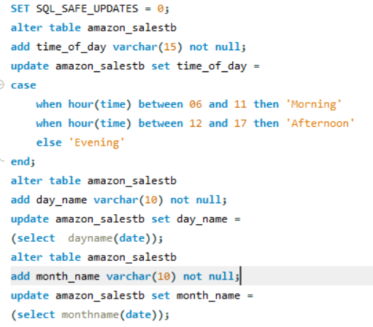
Feature Engineering
In this step we are creating new columns named time of day, day name, month name by extracting values from date and time column. This will help us to analyses and answer sales based on time-of-day(Morning, Afternoon, Evening),day-of-week(Sunday to Saturday)and month(Jan-March).

Slide 5
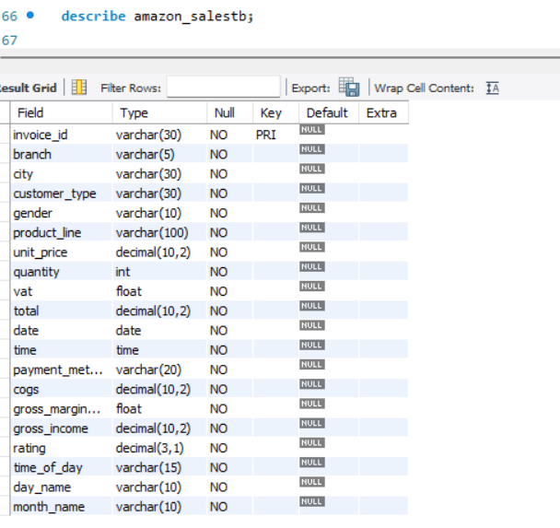
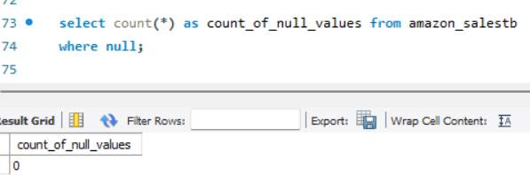
Steps: Checking null values and datatypes of columns of demo amazon table. Note: as observe the datatype are incorrect and column names contain space which is syntactically incorrect, also table has no null values . This correction is done in EDA.

Slide 6
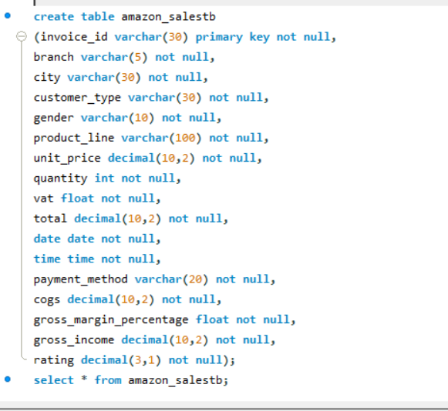
Exploratory Data Analysis Step []: Creating new table named Amazon Sales by adding correct column names, datatypes, constraints while copying values from demo table Amazon.

Slide 7
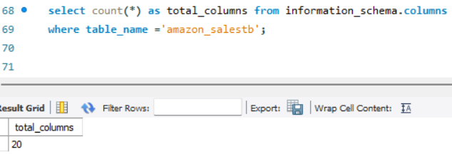
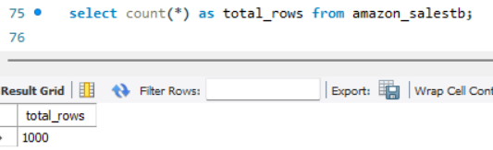
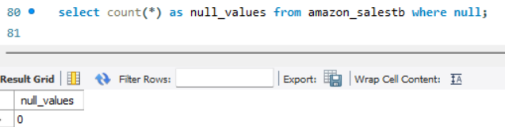
Steps : Checking size of table, count of null values in columns.

Slide 8
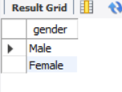
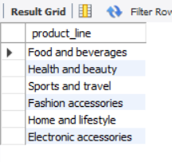
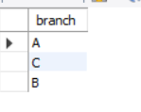
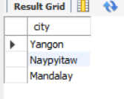
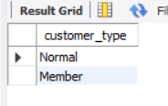
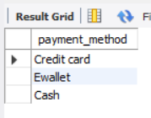
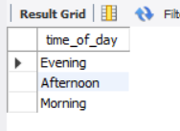
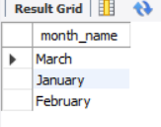
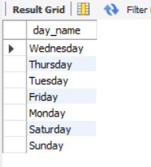
Steps: Checking the unique values in each categorical columns . There are 10 categorical columns like Invoice Id,. As given below

Slide 9
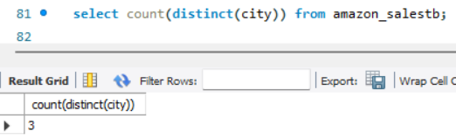
1. What is the count of distinct cities in the dataset?

Slide 10
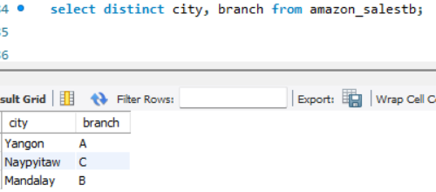
2. For each branch, what is the corresponding city?

Slide 11
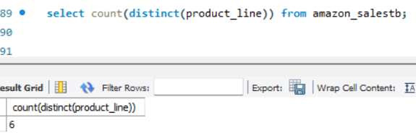
3. What is the count of distinct product lines in the dataset?

Slide 12
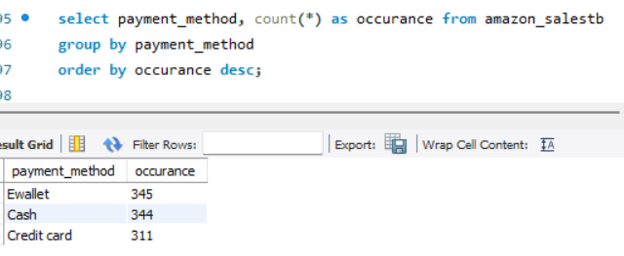
4. Which payment method occurs most frequently?

Slide 13
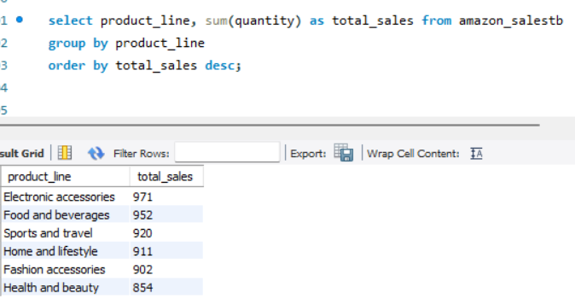
5.Which product line has the highest sales?

Slide 14
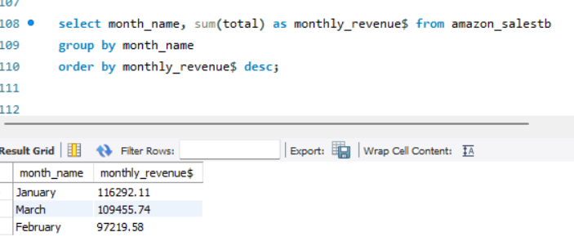
6. How much revenue is generated each month?

Slide 15
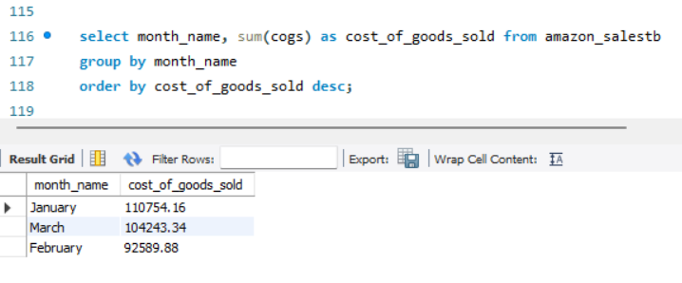
7. In which month did the cost of goods sold reach its peak?

Slide 16
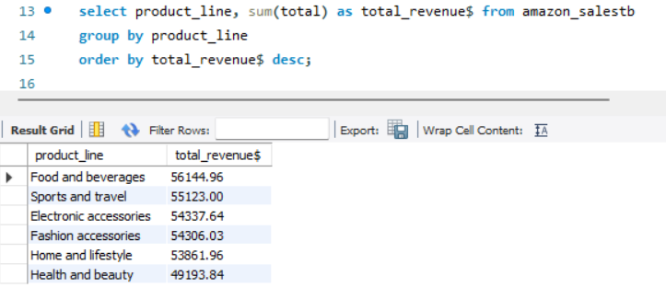
8. Which product line generated the highest revenue?

Slide 17
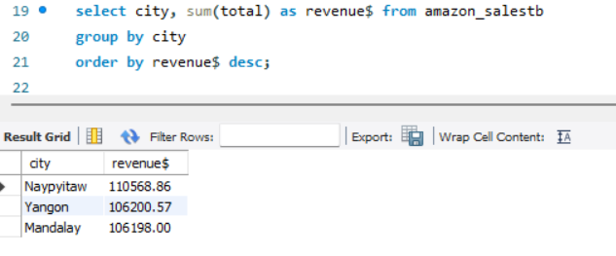
9. In which city was the highest revenue recorded?

Slide 18
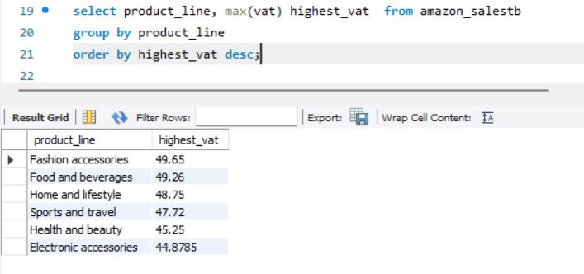
10. Which product line incurred the highest Value Added Tax?

Slide 19
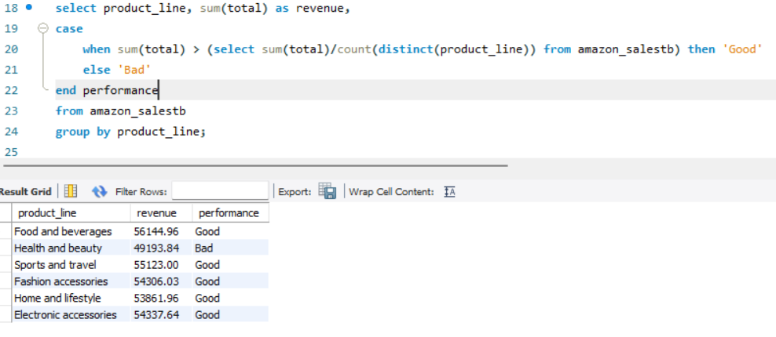
11. For each product line, add a column indicating "Good" if its sales are above average, otherwise "Bad."

Slide 20
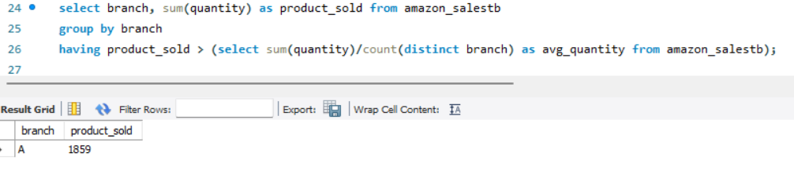
12. Identify the branch that exceeded the average number of products sold.

Slide 21
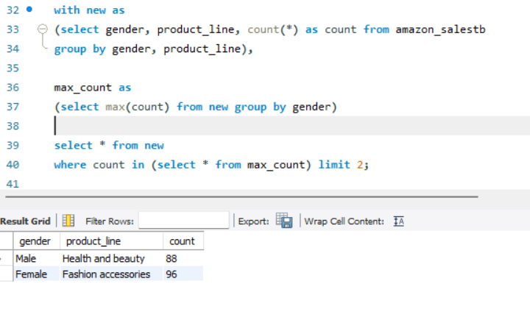
13. Which product line is most frequently associated with each gender?

Slide 22
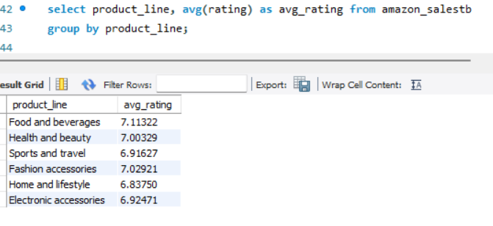
14. Calculate the average rating for each product line.

Slide 23
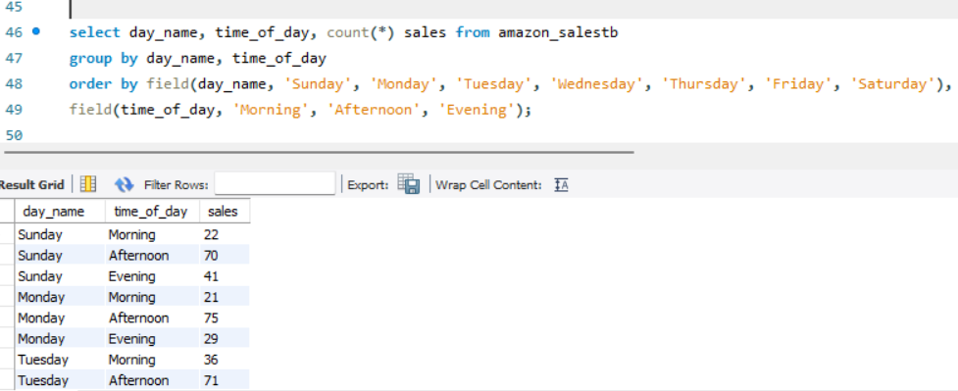
15. Count the sales occurrences for each time of day on every weekday.

Slide 24
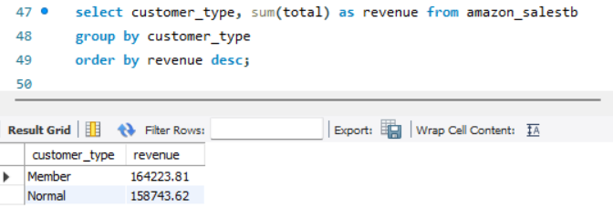
16. Identify the customer type contributing the highest revenue.

Slide 25
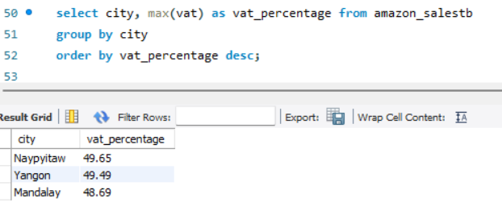
17. Determine the city with the highest VAT percentage.

Slide 26
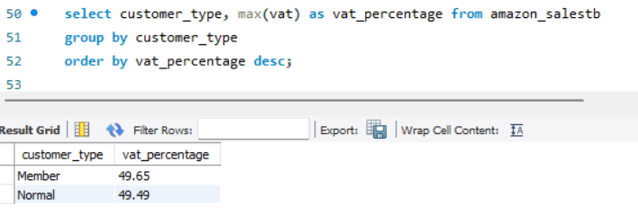
18. Identify the customer type with the highest VAT payments.

Slide 27
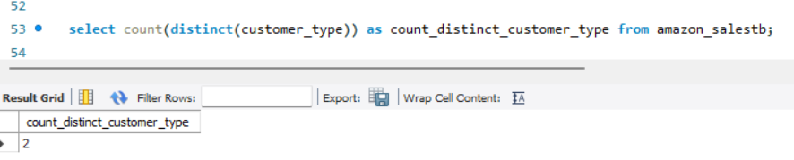
19. What is the count of distinct customer types in the dataset?

Slide 28
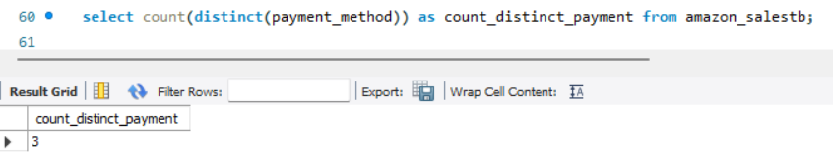
20. What is the count of distinct payment methods in the dataset?

Slide 29
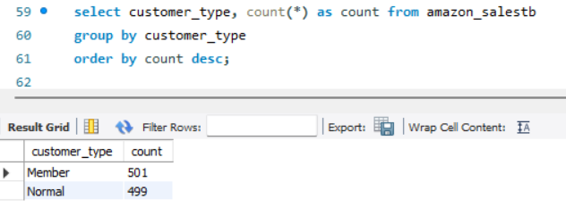
21. Which customer type occurs most frequently?

Slide 30
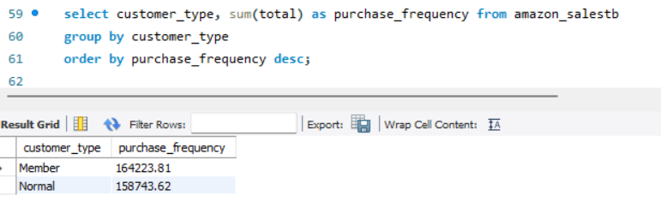
22. Identify the customer type with the highest purchase frequency.

Slide 31
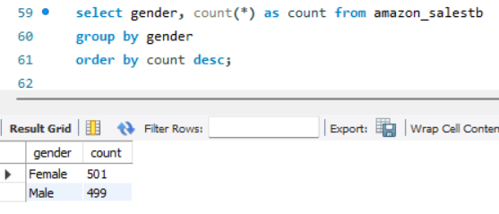
23. Determine the predominant gender among customers.

Slide 32
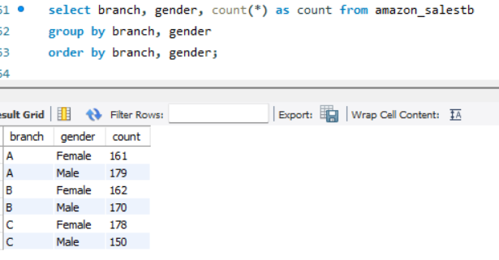
24. Examine the distribution of genders within each branch.

Slide 33
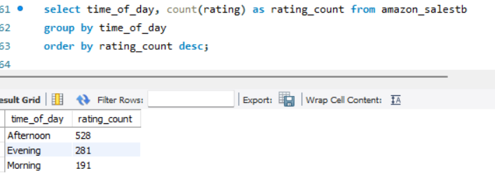
25. Identify the time of day when customers provide the most ratings.

Slide 34
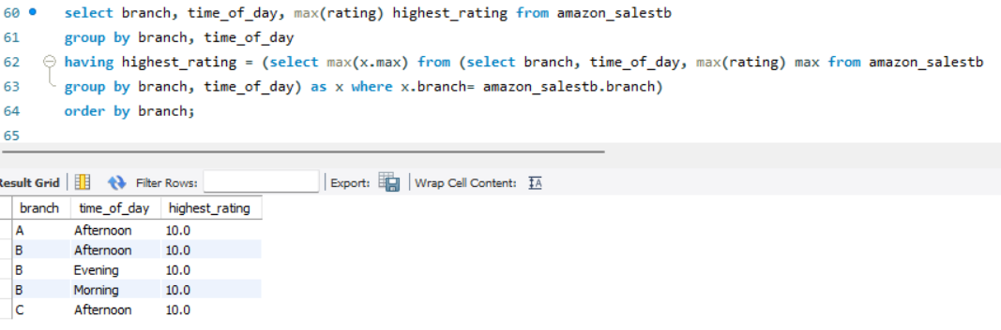
26. Determine the time of day with the highest customer ratings for each branch.

Slide 35
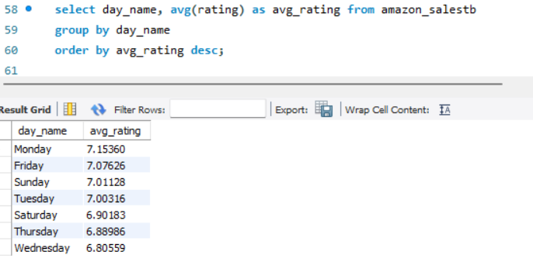
27. Identify the day of the week with the highest average ratings.

Slide 36
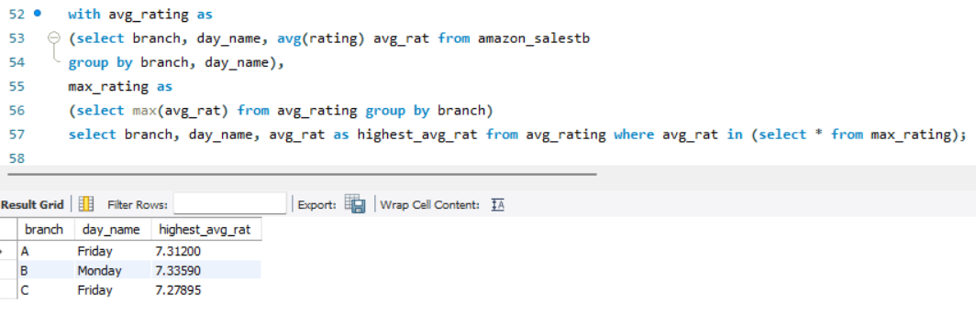
28. Determine the day of the week with the highest average ratings for each branch.

Slide 37
Key Findings
Product Analysis:
Highest Sales Product Line: Electronic Accessories (Units Sold:971)
Highest Revenue Product Line: Food and Beverages ($ 56144.96)
Lowest Sales Product Line: Health and Beauty (Unit Sold: 854)
Lowest Revenue Product Line: Health and Beauty ($ 49193.84)
Sales Analysis:
Month With Highest Revenue: January ($ 116292.11)
City & Branch With Highest Revenue: Naypyitaw[C] ($ 110568.86)
Month With Lowest Revenue: February ($ 97219.58)
City & Branch With Lowest Revenue: Mandalay[B] ($ 106198.00)
Peak Sales Time Of Day: Afternoon
Peak Sales Day Of Week: Saturday

Slide 38
Customer Analysis:
Most Predominant Gender: Female
Most Predominant Customer Type: Member
Highest Revenue Gender: Female ($ 167883.26)
Highest Revenue Customer Type: Member ($ 164223.81)
Most Popular Product Line (Male): Health and Beauty
Most Popular Product Line (Female): Fashion Accessories
Distribution Of Members Based On Gender: Male(240) Female(261)
Sales Male: 2641 units
Sales Female: 2869 units

